Slide 1
Chapter 2 Covering circuits and graph coloring

Slide 2
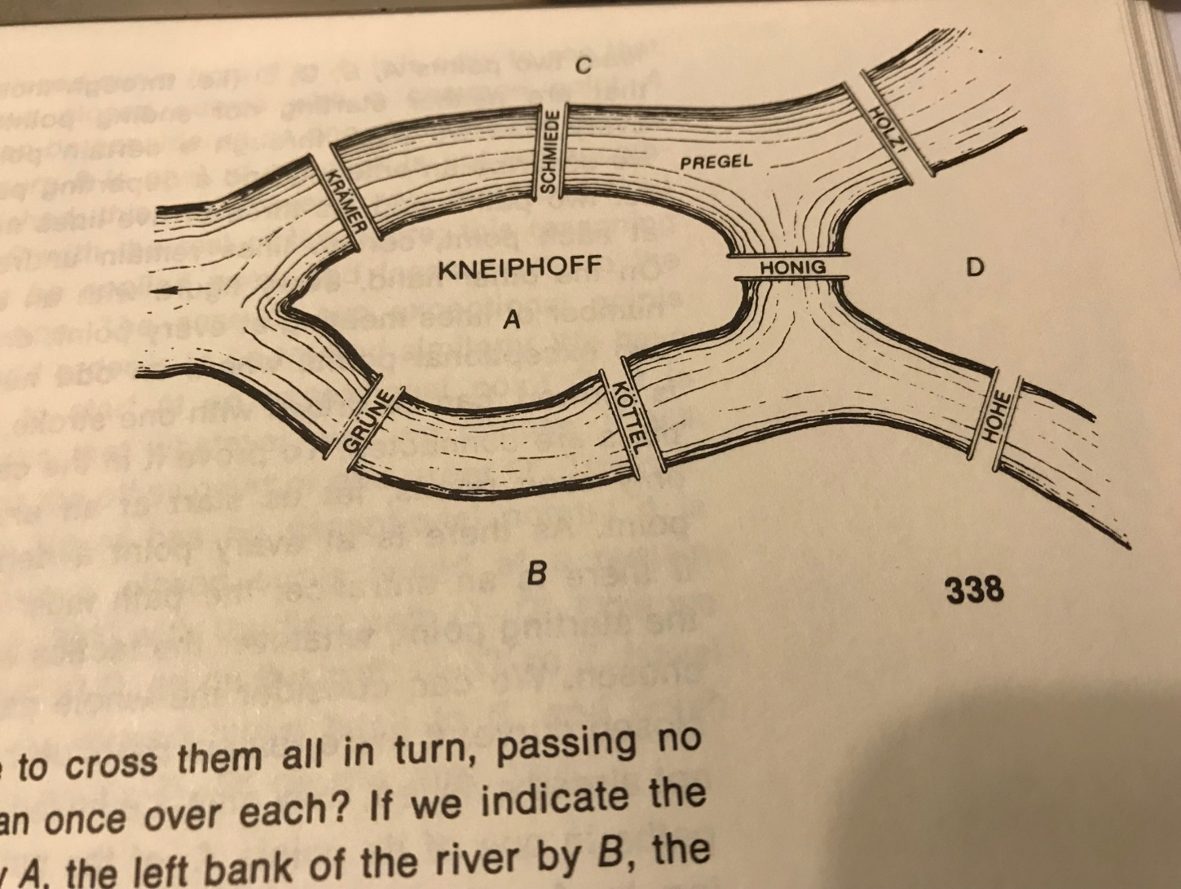
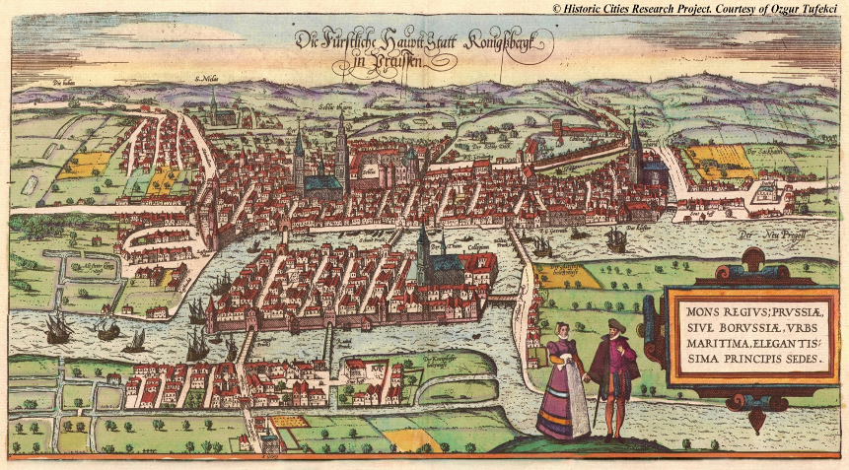
The bridges of Königsberg
*(Kaliningrad today)

Slide 3
Euler Cycle
The question of Konigsberg citizen to Euler: “can we go for a walk and cross
every bridge exactly once?”

Slide 4
Theorem
An undirected (multigraph) graph has an Euler cycle if and only if it is connected and all vertices have even degrees.
This is a connected graph with all vertices of even degree, therefore it must have an Euler cycle.

Slide 5
Cycle:
A sequence of consecutively linked edges whose starting vertex is the ending vertex, in which no edge can appear more than once. However, vertices can be repeated.
e.g.
a b
h c
g d
C=a-h-g-f-e-d-f-a
f e
Euler Cycle:
A path (trail) through a graph which starts and ends at the same vertex and
includes every edge exactly once (vertices may be repeated).
a b
h c
E = a-b-c-d-e-f-g-h-a-d-h-e-b-g-c- f-a
g d
f e

Slide 6
Trail: A sequence of consecutively linked edges in which no edge can appear more than once. . Unlike a path, a vertex can be visited more than once in a trail.
e.g.
Start
End
Euler Trail:- A trail that contains all the edges in a graph (and visits each edge exactly once).

Slide 7
Example
c
Here the graph H does not have an Euler cycle because there are 2 odd degree vertices, namely vertex ‘k’ and vertex ‘a’.
a
b
l d
k e
Therefore if and only if the edge (k , a) were completed then H would have an Euler Cycle.
j f
h
i g
Graph H

Slide 8
Proof
An Euler cycle all vertices are connected and have even degree
Assume a graph is connected and all vertices have even degrees. We start from any vertex and walk through a path along edges, every time the path enters a vertex it also exits because the degree is even. It only stops when the path reaches the starting vertex.
This graph is connected and all vertices have even degrees, therefore it has an Euler cycle.

Slide 9
Proof
All even and connected Euler cycle
a
b
e
f
c
d
g
h
i
j
k
l
Pick any point on G. ( e. g. starting from a)
Since all vertices have an even degree, we are not forced to stop until we complete the cycle. (get back to the starting point)

Slide 10
Proof cont’d
Path created by C
a b
For example, let C equal the cycle created,
c
d e f
C = a-d-h-k-l-i-j-f-e-b-a
g
h i j
k l
If there are any unused edges, and in this case there are, then create another cycle starting with any edge adjacent to C.
a b
This is the cycle created by D in Blue
c
d e f
D = d-e-i-h-g-c-d
g
h i j
k l

Slide 11
Proof cont’d
Since C and D were originally connected, there must be at least one common vertex; pick one (point d)
Build a new cycle C´, by putting D into C at the common point to get a larger cycle.
C´ = D + C
C´ is presented on the next slide

Slide 12
Proof Cont’d
a b
c d e
f
g h i
j
k l
All the edges have been used exactly once, so we have an Euler cycle.
If all the edges were not used, we would simply pick one adjacent to C´ and repeat the process.

Slide 13
Corollary
A graph has an Euler trail, but not an Euler cycle, if and only if it is connected and has exactly two vertices of odd degree.
Proof
Suppose a graph H has an Euler trail T, but not an Euler cycle.
The starting and ending vertices of T must have odd degree while all other vertices have an even degree (by the same reasoning that showed all vertices with even degree in an Euler cycle). Also the graph must be connected.
start
end

Slide 14
On the other hand if a multigraph H is connected and has exactly two vertices, p and q, of odd degree, then to obtain a graph H´, add a supplementary edge (p,q) to H.
p q
H´ is now connected and has all vertices of even degree. Therefore by the Euler cycle theorem, H´ has an Euler cycle C.
If you removed the edge (p,q) from C, this reduces the Euler cycle to an Euler trail that includes all of edges of H. Hence the corollary.

Slide 15
Euler cycle for complete graphs
: Euler trail – Yes- exactly two vertices of odd degree.
Euler cycle – No- vertices are not of even degree.
: Euler trail – No- vertices are not of odd degree.
Euler cycle – Yes- even degree vertices.
: Euler trail – No- more than two vertices of odd degree.
Euler cycle – No- there aren’t any even degree vertices.
: Euler trail – No- there are no vertices of odd degree.
Euler cycle – Yes- cycle is connected and even degree.
: Euler trail – No- more than two vertices of odd degree.
Euler cycle – No- there aren’t any even degree vertices.
.
: Euler trail – No- more than two vertices of odd degree.
Euler cycle – No- there aren’t any even degree vertices.
In general has Euler cycle if n is an odd number.

Slide 16
Euler cycle for complete bipartite graphs

Slide 17
Class Exercise
Give an undirected 12 edge graph, that has an Euler cycle.
B. Can a graph with an Euler cycle have a bridge (an edge whose removal disconnects the graph)?
Answers
All vertices have even degree
Is connected
A.
B. No. If you start on one side of the bridge and then you cross it the only way you can get back to where you started, is to cross the bridge again. This means you have to travel the same edge twice and thus, a Euler cycle cannot exist.

Slide 19
Summary of Previous Class
Euler cycle/trail
Existence of Euler cycle/trail
Euler cycle/trail on complete graphs
The street sweeper’s solution
The street sweeper want to walk through every street without repeating them

Slide 20
Does this graph have Euler trail?
1
4
5
2
7
6
3

Slide 21
Remove which edge will give you Euler trail?
1
4
5
2
7
6
3

Slide 22
Some terminology
Trail: walk with distinct edges, may repeat vertices
Cycle: closed trail
Euler trail: goes over all edges
Euler cycle: closed Euler trail
Path: trail with distinct vertices
Circuit: closed path
Hamilton path: goes over all vertices
Hamilton circuit: closed Hamilton path

Slide 23
Hamilton circuit/path the postman’s solution
Hamilton Path – A path that visits each vertex in a graph exactly once.
F
Possible Hamilton Path:
A-F-E-D-B-C
F
A
B
B
D
D
C
C
E
E

Slide 24
Hamilton Circuit – A circuit that visits each vertex in a graph exactly once.
F
Possible Hamilton Circuit:
A-F-E-D-C-B-A
A
B
D
C
E

Slide 25
Rule 1
If a vertex x has degree 2, both of the edges incident to x must be part of any Hamilton Circuit.
F
A
Edges FE and ED must be included in a Hamilton Circuit if one exists.
B
D
C
E

Slide 26
Rule 2
Once the Hamilton Circuit is required to use two edges at a vertex x, all other (unused) edges incident at x can be deleted.
F
A
B
If edges FA and FE are required in a Hamilton Circuit, then edge FD can be deleted in the circuit building process.
D
C
E

Slide 27
Rule 3
No subcircuit not containing all vertices can be formed when building a Hamilton Circuit.
Edges FE, FD, and DE cannot all be used in a Hamilton Circuit.
F
A
B
D
C
E

Slide 28
Example
Using rules to determine if either a Hamilton Path or a Hamilton Circuit exists.
A
B
D
C
E
F
G
H
I
J
K

Slide 29
Using Rules
Rule 1 tells us that the red edges must be used in any Hamilton Circuit.
A
Vertices A and G are the only vertices of degree 2.
B
D
C
E
H
F
G
I
K
J

Slide 30
Using Rules
Rules 3 and 1 advance the building of our Hamilton Circuit.
A
B
Since the graph is symmetrical, it doesn’t matter whether we use edge IJ or edge IK.
If we choose IJ, Rule 3 lets us eliminate IK making K a vertex of degree 2.
By Rule 1 we must use HK and JK.
D
C
E
F
G
H
I
J
K

Slide 31
Using Rules
All the rules advance the building of our Hamilton Circuit.
A
B
D
C
Rule 2 allows us to eliminate edge EH and Rule 3 allows us to eliminate FJ. Now, according to Rule 1, we must use edges BF, FE, and CH.
E
F
G
H
I
J
K

Slide 32
Using Rules
Rule 2 tells us that no Hamilton Circuit exists.
A
B
D
C
Since the circuit A-C-H-K-J-I-G-E-F-B-A that we were forced to form does not include every vertex (missing D), it is a subcircuit. This violates Rule 2.
E
F
G
H
I
J
K

Slide 33
Theorem 1
A graph with n vertices, n > 2, has a Hamilton circuit if the degree of each vertex is at least n/2.
A
C
n = 6 n/2 = 3 Possible Hamilton Circuit: A-B-E-D-C-F-A
B
E
D
F

Slide 34
The condition in Theorem 1 is sufficient, but not necessary
Theorem 1 does not necessarily have to be true in order for a Hamilton Circuit to exist. Here, each vertex is of degree 2 which is less than n/2 and yet a Hamilton Circuit still exists.
F
F
A
B
B
D
D
C
C
E

Slide 35
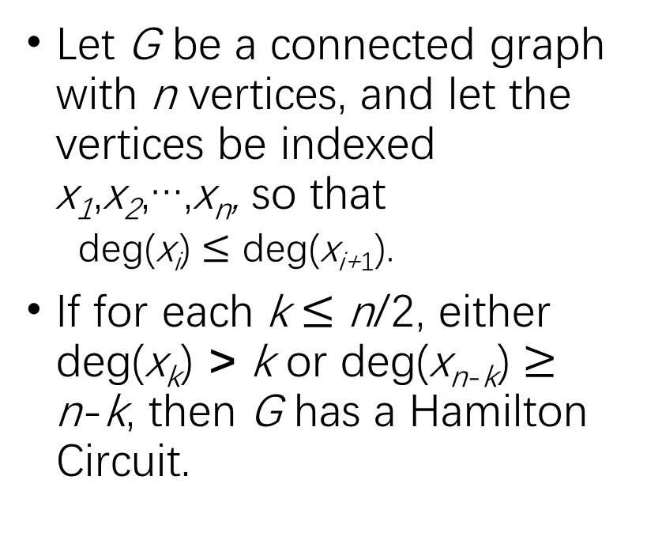
Theorem 2
X₂
Let G be a connected graph with n vertices, and let the vertices be indexed x₁,x₂,…,x_{n}, so that
deg(x_{i}) $≤$ deg(x_{i+1}).
If for each k $≤$ n/2, either deg(x_{k}) > k or deg(x_{n-k}) $≥$ n-k, then G has a Hamilton Circuit.
X₄
X₅
X₆
X₁
X₃
n/2 = 3 k = 3,2,or 1 Possible Hamilton Circuit: X₁-X₅-X₃-X₄-X₂-X₆-X₁

Slide 36
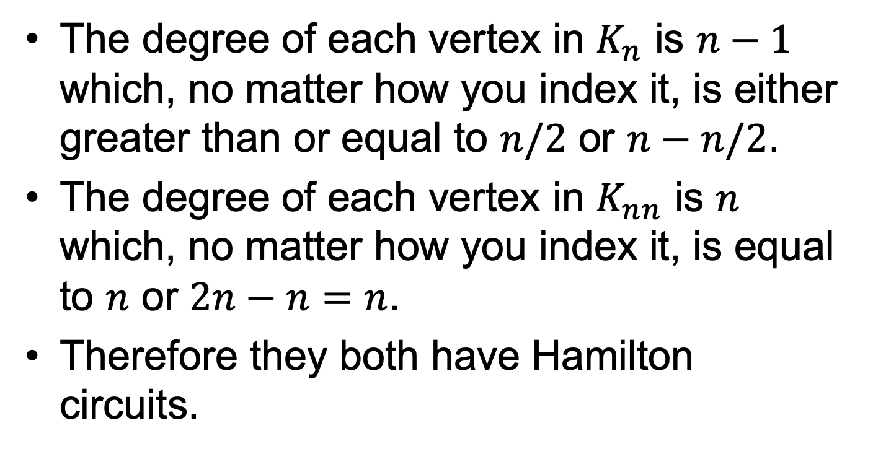

Complete graphs: $K_{n}$ and $K_{nn}$
The degree of each vertex in $K_{n}$ is $n−1$ which, no matter how you index it, is either greater than or equal to $n/2$ or $n−n/2$.
The degree of each vertex in $K_{nn}$ is $n$ which, no matter how you index it, is equal to $n$ or $2n−n=n$.
Therefore they both have Hamilton circuits.

Slide 37
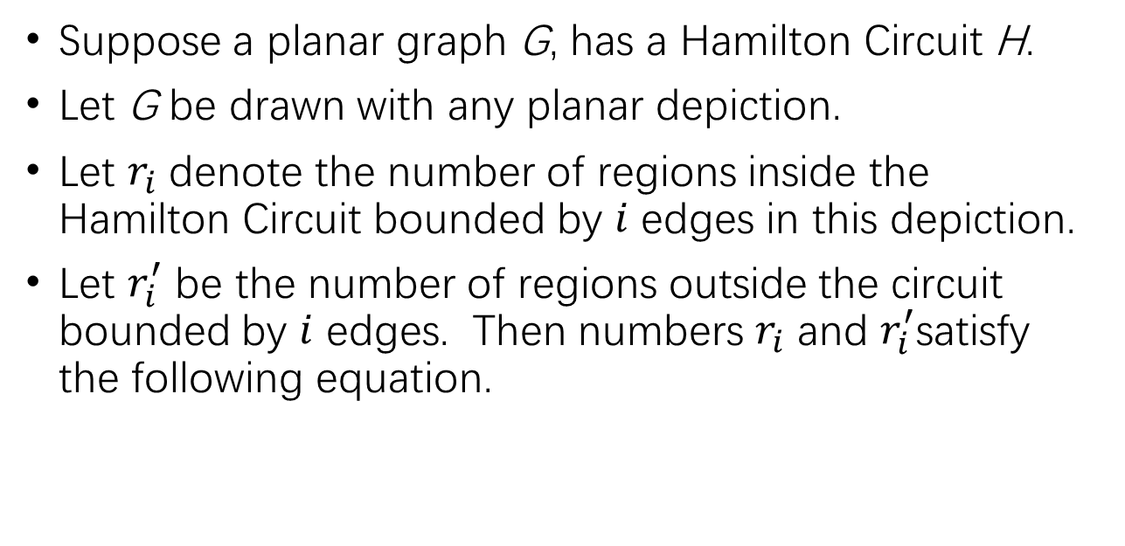
Theorem 3
Suppose a planar graph G, has a Hamilton Circuit H.
Let G be drawn with any planar depiction.
Let $r_{i}$ denote the number of regions inside the Hamilton Circuit bounded by $i$ edges in this depiction.
Let $r_{i}^{′}$ be the number of regions outside the circuit bounded by $i$ edges. Then numbers $r_{i}$ and $r_{i}^{′}$satisfy the following equation.

Slide 38
Use of Theorem 3
Planar Graph G
4
6
6
6
No matter where a Hamilton Circuit is drawn (if it exists), we know that and
. Therefore, and must have the same parity and
.
6
4
4
6
6

Slide 39
Use of Theorem 3 Cont’d
(1)
Consider the case .
This is impossible since then the equation would require that which is impossible since .
We now know that , and therefore .
Now we cannot satisfy Eq. (1) because regardless of what possible value is taken on by , it cannot compensate for the other term to make the equation equal zero.
Therefore, no Hamilton Circuit can exist.

Slide 40
Does this graph have Hamilton circuit?
A
B
C
D
E
F
G
H

Slide 41
Solution
By Rule One, the red edges must be used
Since the red edges form subcircuits, Rule Two tells us that no Hamilton Circuits can exist.
A
B
C
D
E
F
G
H

Slide 42
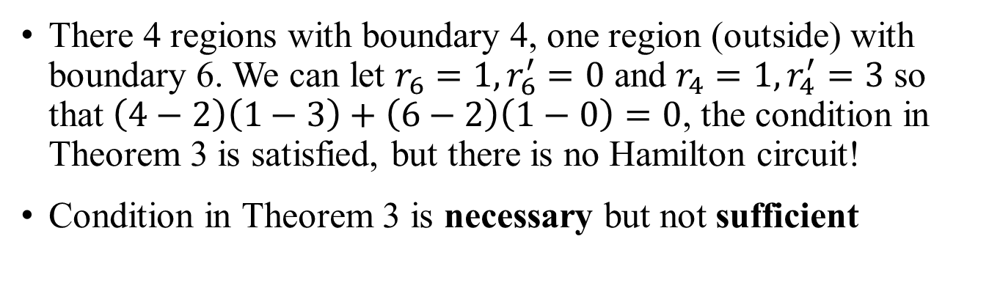
Re-examine Theorem 3
A
B
C
D
E
F
G
H
There 4 regions with boundary 4, one region (outside) with boundary 6. We can let $r_{6}=1, r_{6}^{′}=0$ and $r_{4}=1, r_{4}^{′}=3$ so that $\left(4−2\right)\left(1−3\right)+\left(6−2\right)\left(1−0\right)=0$, the condition in Theorem 3 is satisfied, but there is no Hamilton circuit!
Condition in Theorem 3 is necessary but not sufficient

Slide 43
Does this graph have Hamilton path?
A
B
C
D
E
F
G
H

Slide 44
Amendment to Euler cycle for directed graph
Euler cycle exist in directed graph if any only if
The graph is connected
For every vertex in the graph, the in-degree equals the out-degree

Slide 45
Can this directed graph have Euler cycle?

Slide 46
Summary of previous lecture
Hamilton circuit/path
Visit every vertex exactly once (once and only once)
Postman’s solution
Three rules to construct the Hamilton circuit
Any vertex with degree 2, its two incident edges must be included in the Hamilton circuit
If two edges of a vertex have already been used, the remaining edges must not be included
There can be no sub-circuit
The three theorems about the existence of Hamilton circuit

Slide 47
Does this graph have Hamilton circuit?

Slide 48
Three types of Conditions
Necessary condition
If the condition is violated, it cannot be true
Sufficient condition
If the condition is satisfied, it must be true
Necessary and sufficient condition
If the condition is satisfied, it is true; if the condition is violated, it cannot be true

Slide 49
Theorem 4
Every tournament has a directed Hamilton Path.
Tournament – A directed graph obtained from a (undirected) complete graph, by giving a direction to each edge.
A
B
The tournaments (Hamilton Paths) in this graph are:
A-D-B-C, B-C-A-D, C-A-D-B, D-B-C-A, and D-C-A-B.
C
(K₄, with arrows)
D

Slide 50
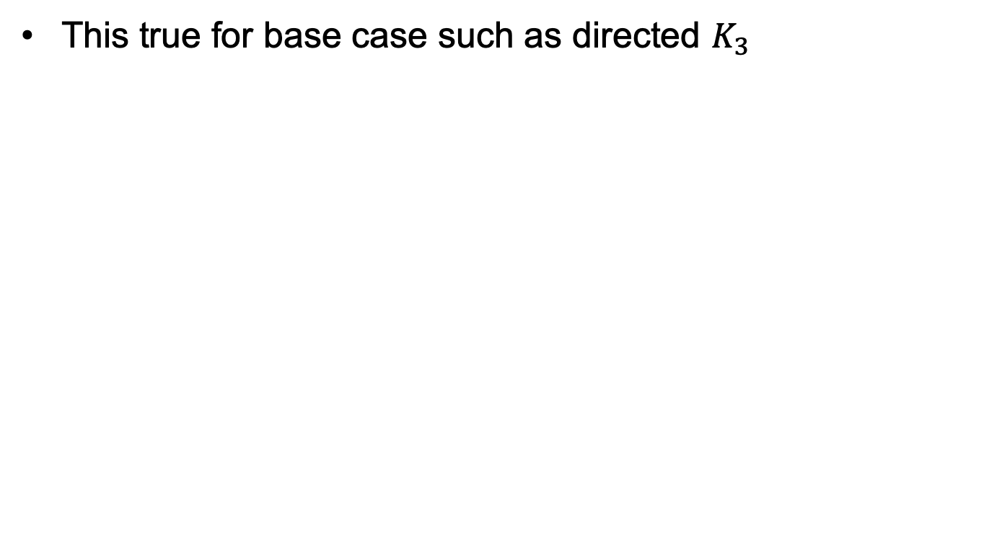
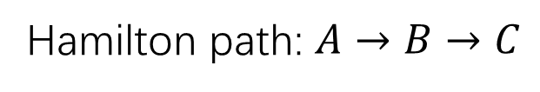
Proof (inductive method):
This true for base case such as directed $K_{3}$
Hamilton path: $A→B→C$

Slide 51
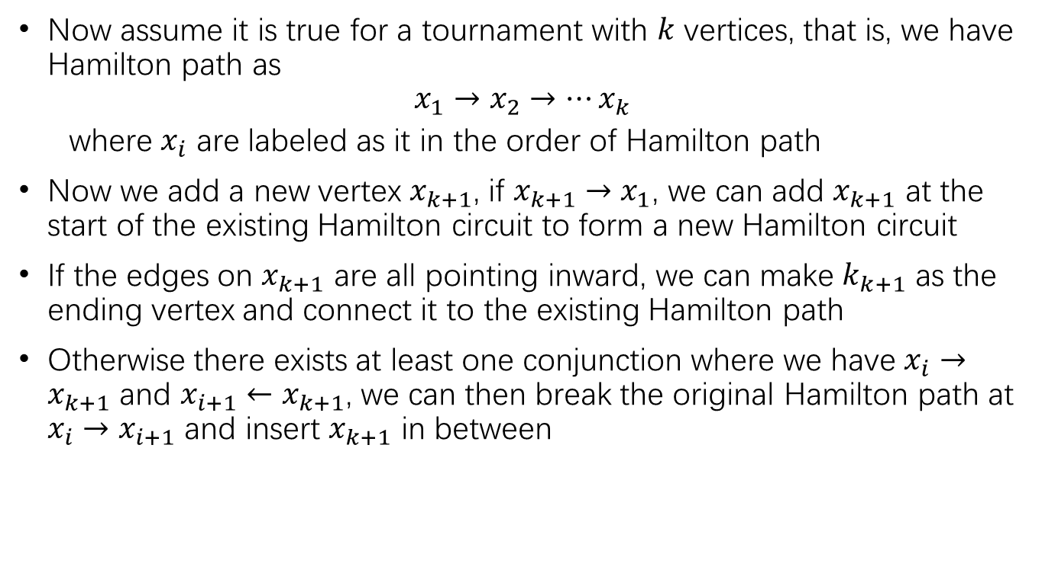
Proof (continue):
Now assume it is true for a tournament with $k$ vertices, that is, we have Hamilton path as
$$x_{1}→x_{2}→⋯x_{k}$$
where $x_{i}$ are labeled as it in the order of Hamilton path
Now we add a new vertex $x_{k+1}$, if $x_{k+1}→x_{1}$, we can add $x_{k+1}$ at the start of the existing Hamilton circuit to form a new Hamilton circuit
If the edges on $x_{k+1}$ are all pointing inward, we can make $k_{k+1}$ as the ending vertex and connect it to the existing Hamilton path
Otherwise there exists at least one conjunction where we have $x_{i}→x_{k+1}$ and $x_{i+1}←x_{k+1}$, we can then break the original Hamilton path at $x_{i}→x_{i+1}$ and insert $x_{k+1}$ in between

Slide 52
Bipartite graphs
Bipartite graphs: to have a Hamilton circuit the two parts must have equal numbers of vertices (necessary, not sufficient)
Why? Any circuit in a bipartite graph must have an even number of vertices, and it alternates between the two parts.
So, to get a closed circuit that includes all vertices we must be able to alternate between two sides, eventually returning where we started. Every other vertex on the circuit belongs to one side. Couldn’t do that unless the two sets of vertices have same number of elements.
To have a Hamilton path then we must either have equal numbers (begin in one side, end in the other) or one side may have one vertex more than the other (begin and end in same side).

